Slide 1






IBM Data Science Capstone Project
By Abraham Mulat
01/09/2023

Slide 2

Table of Contents
01
Executive Summary
02
Introduction
03
Methodology
04
Results
05
Conclusion

Slide 3
EXECUTIVE SUMMARY
Methodologies
Data collection
Data wrangling
Exploratory data analysis with data visualization
Exploratory data analysis with SQL
Building an interactive map with Folium
Building a dashboard with Plotly Dash
Predictive analysis (Classification)
Results
Exploratory data analysis results
Interactive data visualization results
Predictive analysis results
Conclusion

Slide 4
1. Introduction
Project background
SpaceX, officially known as Space Exploration Technologies Corp., is an American company based in Hawthorne, California. It specializes in spacecraft manufacturing, launch services, and satellite communications. SpaceX has achieved remarkable success in the field of space exploration, revolutionizing space travel by making it more cost-effective. The company prominently features Falcon 9 rocket launches on its website, offering them at a price of $62 million per launch, a significantly lower cost compared to other providers, which charge upwards of $165 million per launch. A key factor contributing to this cost savings is SpaceX's ability to reuse the first stage of its rockets.
As a result, the cost of a launch is closely tied to the successful landing and reuse of the first stage. This information becomes crucial when competing companies consider bidding against SpaceX for a rocket launch contract. Machine learning models can play a valuable role in predicting whether SpaceX will be able to successfully reuse the first stage, providing valuable insights for decision-making in the competitive world of space exploration.
Problem Definition
How do variables such as payload mass, launch site, number of flights, and orbits affect the success of the first stage landing?
Does the rate of successful landing increase over the years?
What is the best algorithm that can be used for binary classification in this case?

Slide 5
Methodology - Data Collection
Data collection involves gathering relevant data from various sources such as databases, APIs, or data generated internally that will help address the problem.
The objective of this lab is to make a get request to the SpaceX API and do some basic data wrangling and formatting. The steps are as follows:
Get request to
SpaceX API
Decode the response content as a json
Using .json() and turn it into a pandas
dataframe using .json_normalize()
Clean the decoded
dataframe
Replace missing values with the mean value (payload mass)
Filter the dataframe to only
Include Falcon 9 launches

Slide 6
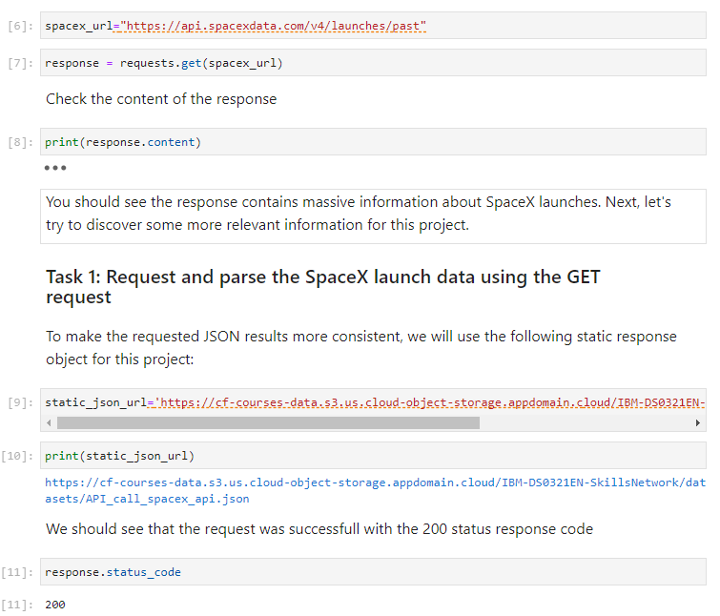
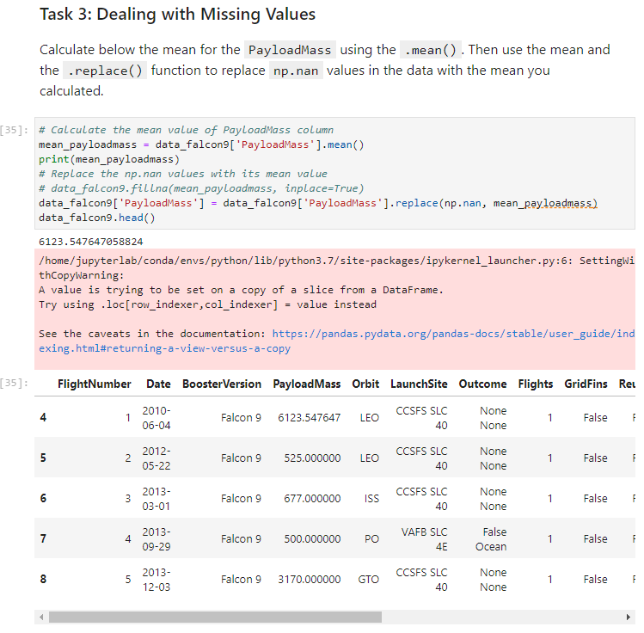
Methodology- Data Collection

Slide 7
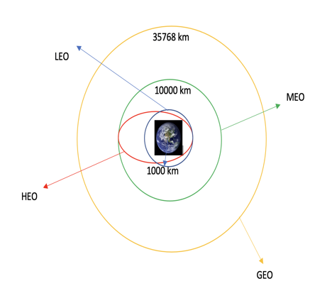
Methodology – Data Wrangling
Data wrangling is the process of cleaning, organizing, and transforming row data into a desirable format for prompt decision making.
In this lab we performed EDA to identify data patterns for labeling supervised models.
In the dataset, we have various cases where booster landings were either successful or unsuccessful, and, we'll transform these outcomes into training labels: 1 for successful landings and 0 for unsuccessful ones.
Additional analysis includes site launches, orbit types, and mission outcomes per orbit type.

Slide 8
Methodology- EDA with SQL
EDA with SQL
Load the SQL extension and establish a connection with the database
Display the names of unique launch sites in the space mission
Display total payload mass carried by boosters launched by NASA (CRS)
Display average payload mass carried by booster version F9 v1.1
List the date when the first successful landing outcome in ground pad was achieved.
List the total number of successful and failure mission outcome.

Slide 9
Methodology- EDA with Visualization
In this lab we performed exploratory data analysis and feature engineering using Pandas and Matplotlib library.
Some of the tasks we performed are listed below:
Visualize the relationship between Flight Number and Launch Site
Visualize the relationship between Payload and Launch site
Visualize the relationship between success rate of each orbit type
Visualize the relationship between Flight Number and Orbit type
Visualize the launch success yearly trend
Create dummy variables to categorical columns

Slide 10
Methodology- Interactive Visual Analytics with Folium
Launch Sites Locations Analysis with Folium
The launch success rate depends on various factors, including payload mass, orbit type, launch site location, and proximity, and analyzing existing launch site locations may reveal some key factors for optimal site selection.
In this lab we performed more interactive visual analytics using Folium
We mark all launch sites on a map
Mark the success/failed launches for each site on the map
Calculate the distance between a launch site to its proximities

Slide 11
Methodology- Interactive Visual Analytics with Folium
In this lab, we built a Plotly Dash application for users to perform interactive visual analytics on SpaceX launch data in real-time.
The dashboard application contains input components such as a dropdown list and a range slider to interact with a pie chart and a scatter point chart.
We add a launch site drop-down input component
A call back function to render success-pie-chart based on selected site dropdown
A range slider to select Payload
Add a call back function to render the success-payload-scatter-chart scatter plot.
The results are shown in the results section.

Slide 12
Methodology- Machine Learning Prediction
In this lab, we created a machine learning pipeline to predict if the first stage will land given the data from the preceding labs.
We use logistic regression, Support Vector Machine (SVM), Decision Tree, and K Nearest Neighbors classification algorithms.
We find the best Hyperparameter for SVM, Decision Tree and Logistic regression algorithm using Grid search method.
We compare the performance of the algorithms on the test data set using different classification metrics and find the best performing algorithm.
The steps of developing a predictive analysis algorithm are shown in the next slide.

Slide 13
Methodology- Machine Learning Prediction
Create a NumPY array from the column “Class” in the data using to_numpy() function
Split the data into training and test data using train_test_split() function
Standardize the data
Using StandardScaler()
Create a GridSearchCV object with cv=10,
Fit the object and find the best parameters
Find the best performing algorithm using the
Jaccard-score, F1-score and accuracy value on the test dataset
Plot and examine the confusion matric for all methods
Calculate the accuracy on the test data using
score() method
Steps of developing machine learning classifier

Slide 14
RESULTS
Exploratory data analysis results
Interactive analytics demo in Screenshots
Predictive analysis results

Slide 15
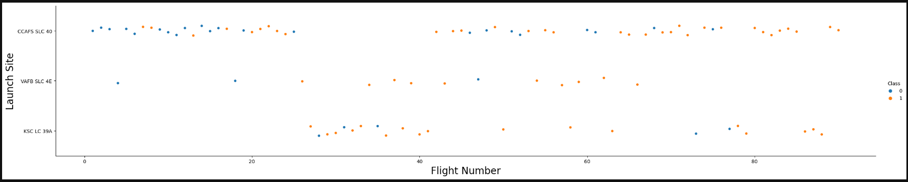
RESULTS – EDA data visualization
Flight Number vs. Launch Site
From the plot, we can see that more flights failed at early stage but the latest flights all succeeded.
VAFB SLC 4E and KSC LC 39A have more success rate than CCAFS SLC 40.
It seems that the new flight will have higher success rate.

Slide 16
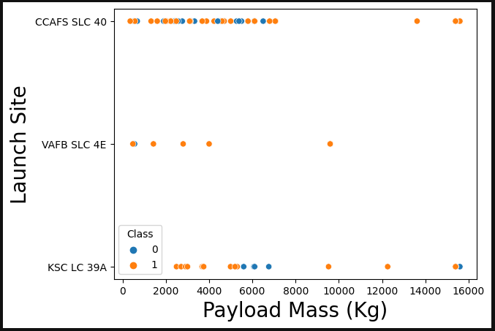
RESULTS – EDA data visualization
Payload Mass (kg) vs. Launch Site
From the payload vs. Launch site scatter point chart, we can observe that there are no rocket launches for VAFB-SLC launch sites for payload mass greater than 10000.
For each launch, most launch sites were successful with a payload mass over 8000 kg.
VAFB SLC 4E and KSC LC 39A had a higher success rate for payload mass under 5500 kg, only one failure for the VAFB SLC 4E.

Slide 17
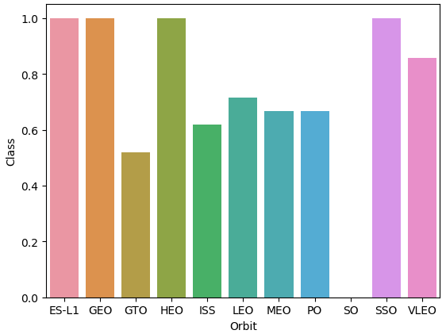
RESULTS – EDA data visualization
Success rate vs. Orbit type
Orbits with 100% success rate:
ES-L1, GEO, HEO, SSO
Orbits with success rate between 50% and 90%
GTO, ISS, LEO, MEO, PO
Orbits with 0% success rate:
SO

Slide 18
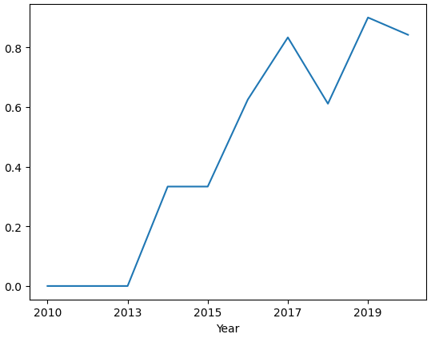
RESULTS – EDA data visualization
Launch success yearly trend
From the plot, we can observe that the success rate kept increasing since 2013 till 2020.

Slide 19
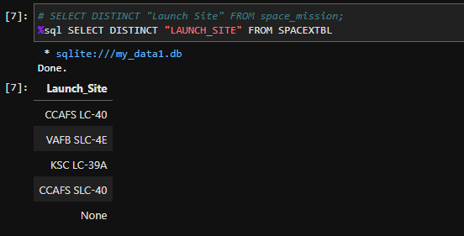
RESULTS – EDA SQL
Names of Unique launch sites in the space mission

Slide 20
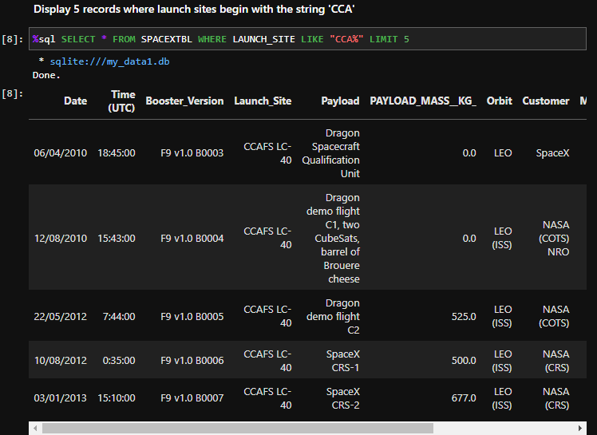
RESULTS – EDA SQL
Launch sites begin with the string ‘CCA’

Slide 21
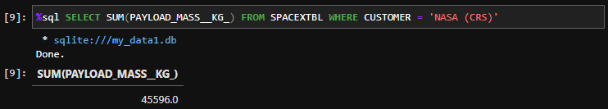
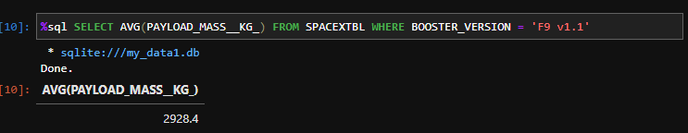
RESULTS – EDA SQL
Total payload mass carried by boosters launched by NASA (CRS)
Average payload mass carried by booster version F9 v1.1

Slide 22
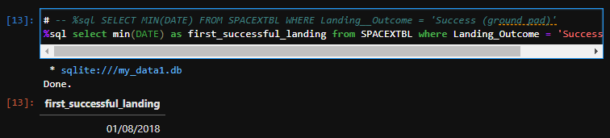
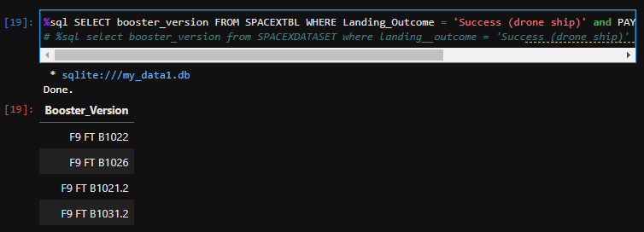
RESULTS – EDA SQL
Successful drone ship landing with payload between 4000 and 6000
First successful ground landing date

Slide 23
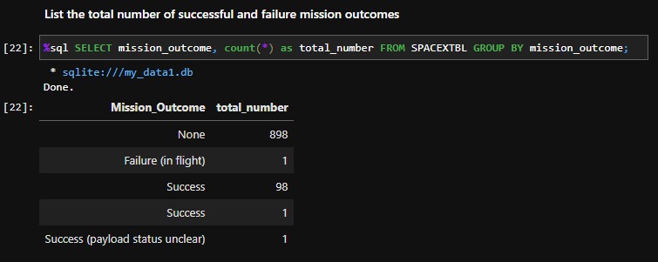
RESULTS – EDA SQL
Total number of successful and failure mission outcomes

Slide 24
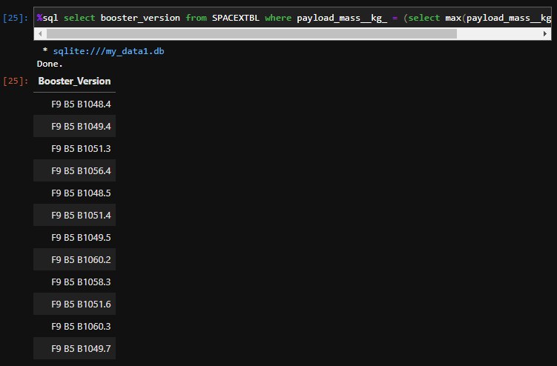
RESULTS – EDA SQL
Boosters carried maximum payload mass

Slide 25
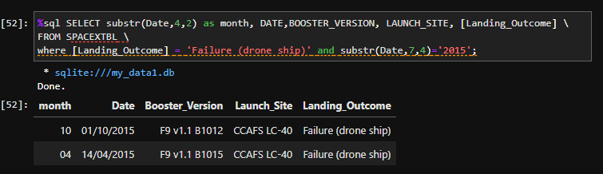
RESULTS – EDA SQL
2015 launch records

Slide 26
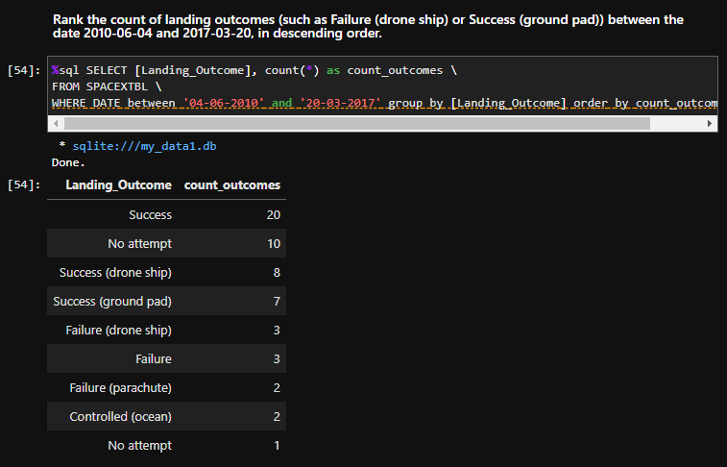
RESULTS – EDA SQL
Rank success count between 2010-06-04 and 2017-03-20

Slide 27
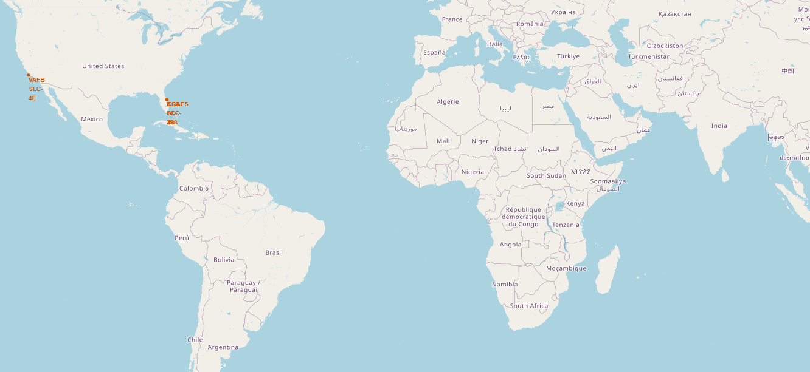
RESULTS – Interactive map with Folium
All launch sites on a map
From the map, we can see that The SpaceX launch sites are in the USA,
California and Florida.

Slide 28
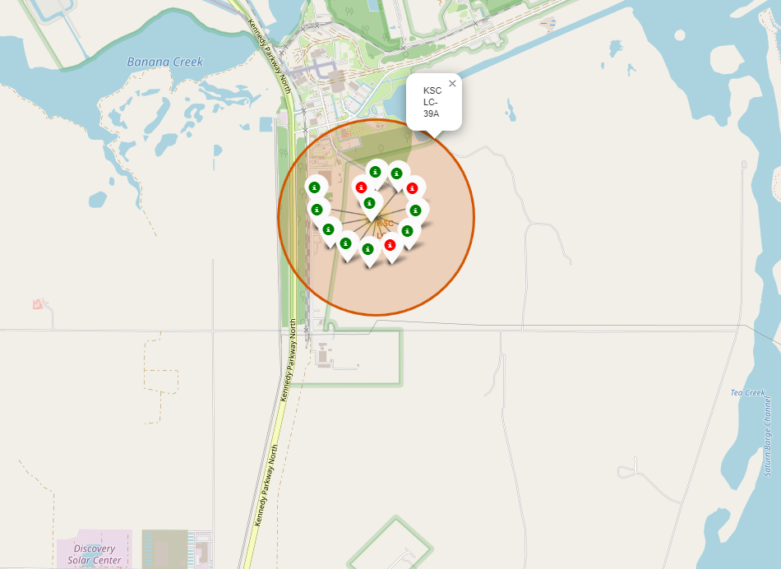
RESULTS – Interactive map with Folium
Color-labeled launch records on the map
Green Marker indicate Successful Launch
Red Marker indicate Failed Launch

Slide 29
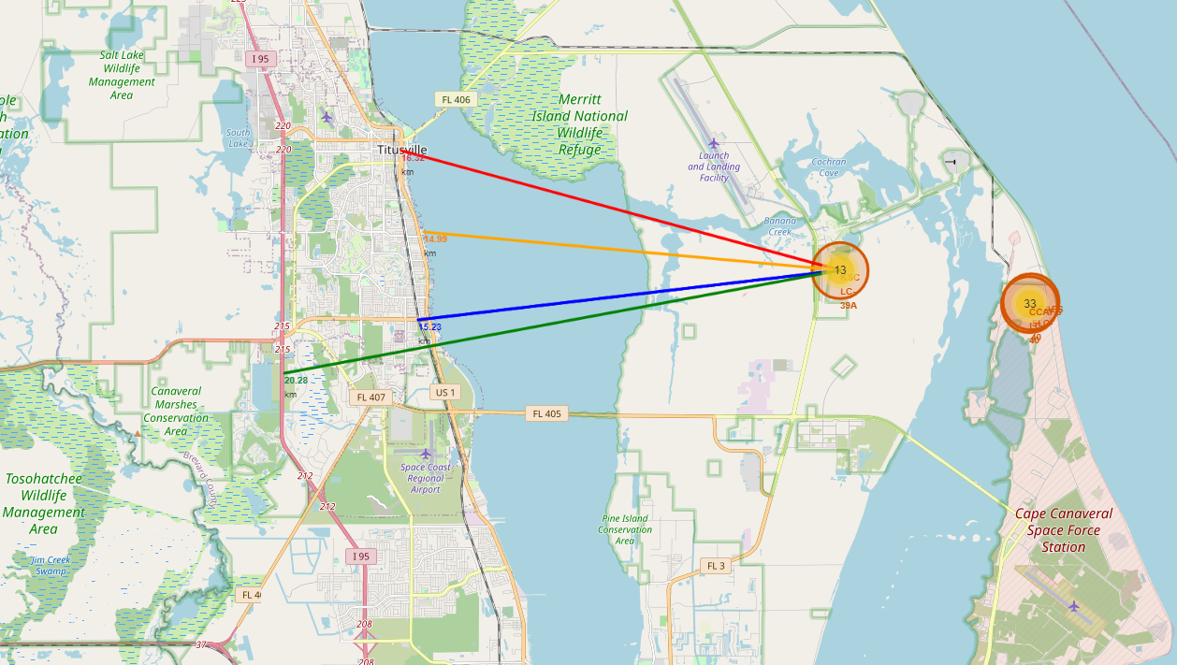
RESULTS – Interactive map with Folium
Distance from the launch site KSC LC-39A to its proximities

Slide 30
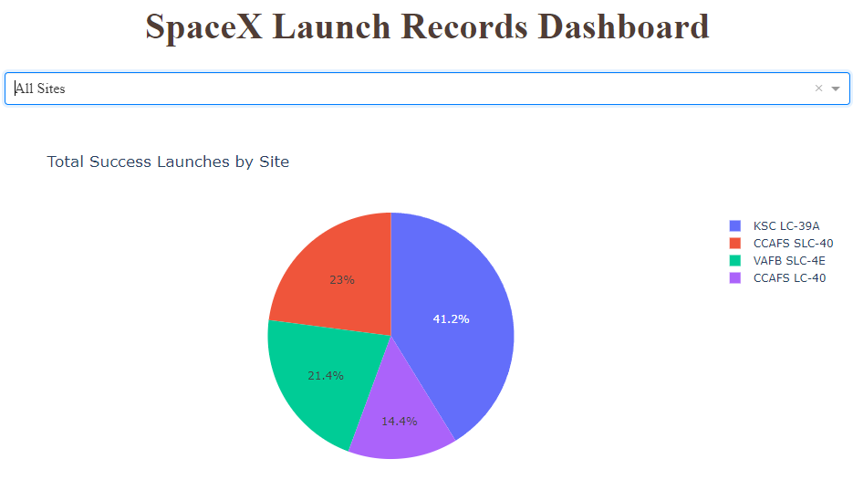
RESULTS – Build a Dashboard with Plotly Dash
Pie chart showing the success percentage achieved by each launch site

Slide 31
RESULTS – Build a Dashboard with Plotly Dash
Pie chart showing the Launch site with the highest launch success ratio

Slide 32
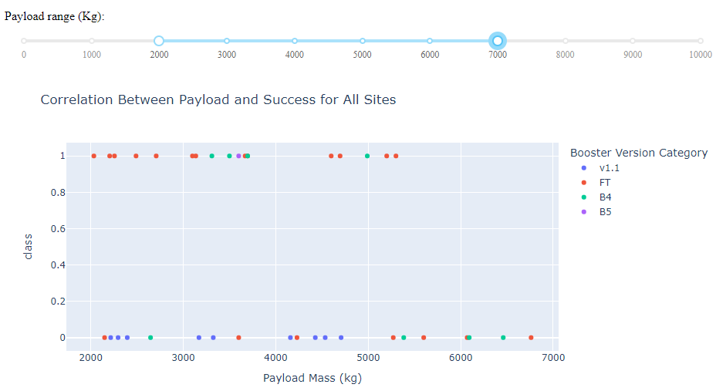
RESULTS – Build a Dashboard with Plotly Dash
Scatter plot of Payload vs Launch Outcome for all sites, with different payload selected in the range slider

Slide 33
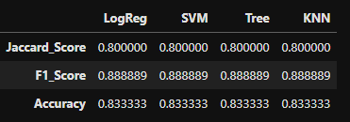
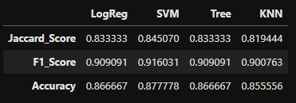
RESULTS – Machine Learning Prediction
Classification Accuracy
Test Set scores alone don't conclusively identify the best method due to the small sample size (18 samples). We assessed all methods on the entire Dataset, which confirmed the Support Vector Machine (SVM) Model as the best performer, displaying superior scores and the highest accuracy.
Performance of each method on test data metrics.
Performance of each method on the whole dataset metrics.

Slide 34
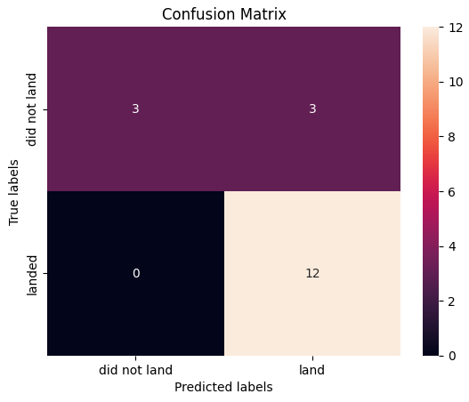
RESULTS – Machine Learning Prediction
Confusion Matrix
The confusion matrix of SVM classifier demonstrates its ability to differentiate between various classes, with a notable issue being false positives – instances where the classifier incorrectly labels unsuccessful landings as successful ones.

Slide 35
CONCLUSION
We can conclude that:
For this task, the Decision tree classifier stands out as the superior machine learning algorithm.
A higher number of flights at a launch site is correlated with an improved success rate.
From 2013 to 2020, the launch success rate exhibited a consistent increase.
Among orbit types, ES-L1, GEO, HEO, SSO, and VLEO recorded the highest success rates.
KSC LC-39A emerged as the site with the highest number of successful launches.

Slide 36
Thank You!!

Slide 37
Special thanks to Instructors IBM and Coursera
APPENDIX

